Slide 1
Category review: Chips
June 2020
Retail Analytics
Brand note: If client logo is not required, use alternate title page layout right click slide thumbnail > Layout > Title

Slide 2
Notes:
To view Privacy video explaining how important data privacy is to Quantium, please click here: https://www.youtube.com/watch?v=Zq1QDAkoRzU
or here Q:\Company Reference\Brand & Design\Brand videos\Q Privacy.mp4
At Quantium, we believe that data is the behavioural footprint of humanity and that it has to be treated with the utmost care and responsibility.
Histories, attitudes, indeed lives are stored within it in ways that aren’t always apparent – and that’s what makes its potential so powerful.
To work with it responsibly, sensitively, we set ourselves the highest data privacy protection and governance standards.
We have spent 17 years perfecting privacy-by-design and secure-by-design principles. Central to this is not holding any personally identifiable information about people –
we neither receive it, and put the necessary protections in place to be unable to decipher it.
Every aspect of handling data is safeguarded: from its de-identification, to its encryption – data security is paramount and of the highest grade.
We pride ourselves on gaining the trust of iconic organisations around the world through years of securely working with their data,
and in turn the trust that builds with their stakeholders.

Slide 3
Executive summary
01
In Task 1, we cleaned and structured over 246,000 transaction records and engineered essential features such as MONTH, STORE, and derived metrics like total sales, customer counts, and average transactions per customer. This enabled the creation of a monthly store-level performance dataset for reliable analysis.
Task 1
Data Exploration & Feature Engineering
In Task 2, we selected appropriate control stores for each trial store by measuring similarity in historical sales and customer trends. We then evaluated trial store performance during the February–April 2019 trial period using statistical testing (Welch’s t-test).
02
Task 2
Trial vs Control Analysis

Slide 4
01
Category
The analysis focuses on chips, one of the key categories in the snack food segment.
Chips represent a high-volume, frequently purchased product, making them ideal for trial strategies.
Customers are typically split by life stage (e.g., young families, retirees) and premium tier (e.g., budget vs. mainstream vs. premium).
Our objective is to understand how customer behavior in the chips category responds to marketing interventions, promotions, or trials.
Insights from this category will guide strategic planning for product placement, pricing, and promotional activity.

Slide 5
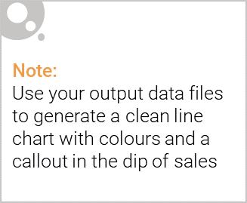
Overview:
Key Insight: The chips category has demonstrated consistent customer engagement, with high purchase frequency and strong response to promotional activity, particularly among mainstream families and budget-conscious retirees.
Supporting Points:
The trial stores showed higher sales uplift in chips compared to control stores during the trial period.
Mainstream and budget tier products dominate sales volume, indicating price sensitivity in consumer behavior.
Promotional efforts in the chips category have the potential to drive both customer retention and acquisition, especially when targeted by lifestage.
Implication for Strategy: The chips category is a high-impact, data-rich segment, making it ideal for testing strategic initiatives like product trials, pricing optimization, and promotional targeting.

Slide 6

Affluence and Its Effect on Chips Buying Behavior
Key Insight: Affluence plays a significant role in shaping chip purchase behavior, with noticeable trends across different economic segments.
Supporting Commentary:
Mainstream shoppers contribute the highest sales volume, indicating their strong affinity for chips and responsiveness to price-driven promotions.
Budget customers are highly price-sensitive and tend to purchase in larger quantities during discounts, driving volume uplifts during promotions.
Premium customers, although fewer in number, prefer higher-priced or niche chip products, suggesting opportunity for premium product trials or bundling strategies.
Strategic Takeaway: Marketing and pricing strategies for chips should be tier-specific:
Focus promotions on mainstream and budget segments to maximize reach and volume.
Introduce premium product innovation or exclusive offers to better engage the affluent segment, encouraging higher basket value.

Slide 7
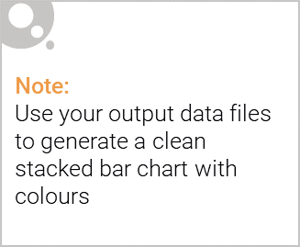
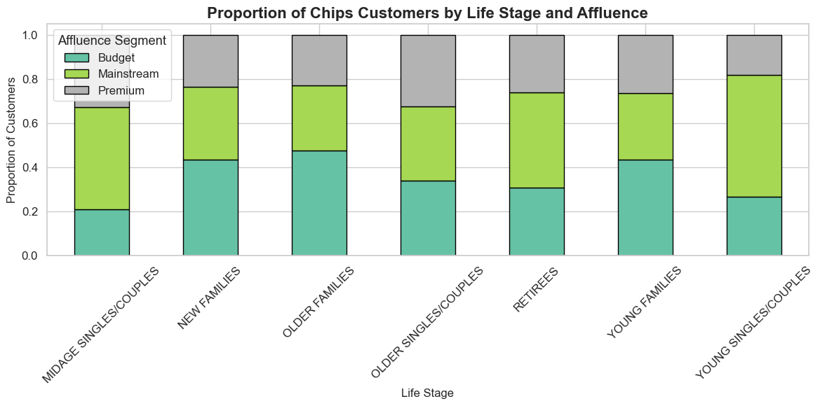
Editable (delete this)
Affluence and Life Stage Impact on Chips Buying Behavior
Overview: Chips consumption varies significantly across customer affluence levels and life stages. Understanding this relationship helps tailor category strategy more effectively.

Slide 8
02
Trial store performance
Stores 77, 86, and 88 were evaluated against matched control stores from Feb–Apr 2019.
Store 77: Strong uplift in revenue and customer count → Successful trial
Store 86: Minimal improvement → Limited impact
Store 88: Inconclusive performance → Needs further analysis
Conclusion: Trial was effective in Store 77. Others may need strategy adjustments before rollout.

Slide 9
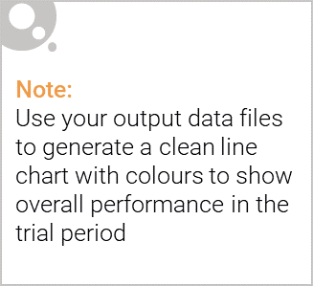
Control Store vs Trial Store
To measure the trial’s true impact, each trial store was compared with a control store that had similar pre-trial behavior.
The control store acts as a baseline, showing what would likely happen without the trial.
This comparison allows us to isolate the effect of the trial from regular sales and customer fluctuations.
Summary:
Store 77 outperformed its control → Trial effective
Stores 86 & 88 showed little difference from controls → Trial impact unclear
Conclusion: Control stores confirmed that only Store 77 had a meaningful uplift due to the trial.

Slide 10
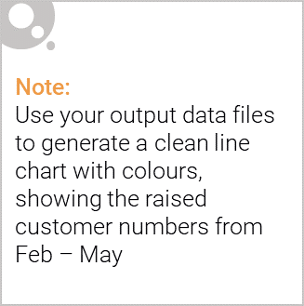
Trial Store Performance Summary
Store 77: Significant uplift in sales revenue and customer count compared to its control store. → Trial was successful and shows potential for broader rollout.
Store 86: Minor improvements, but not statistically significant. → Limited impact, further refinement needed.
Store 88: Inconclusive performance; similar trends seen in control. → No clear benefit, deeper analysis recommended.
Conclusion: The trial succeeded in Store 77, indicating strong customer response. Results from Stores 86 and 88 were not strong enough to confirm trial effectiveness.

